Slide 1
Improving Data Discovery and Integration via Semantics
Matthew B. Jones
NCEAS, UCSB
Ben Adams, NCEAS
Stacy Hespanha, NCEAS
Deborah McGuinness, RPI
Mark Schildhauer, NCEAS
Patrice Seyed, RPI
Data Integration and Semantics Working Group
In collaboration with:
SONet
SemTools

Slide 2
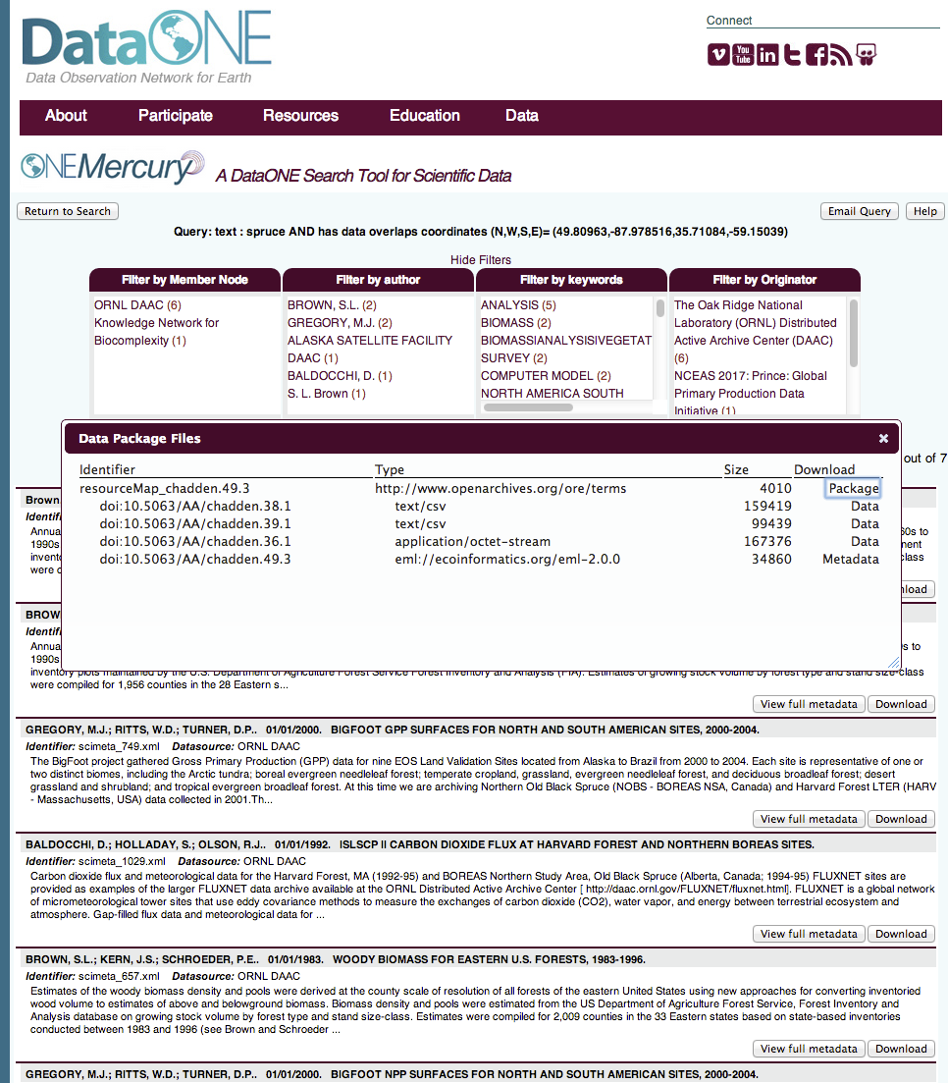
Challenges
Heterogeneity
Many disciplines
Precision
Recall
Data Integration

Slide 3
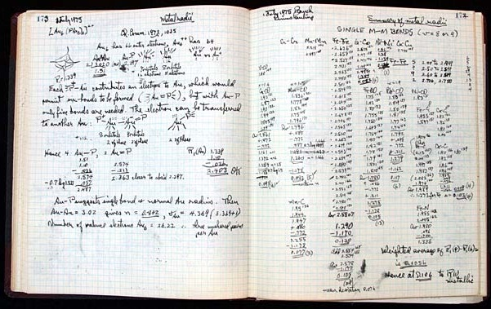
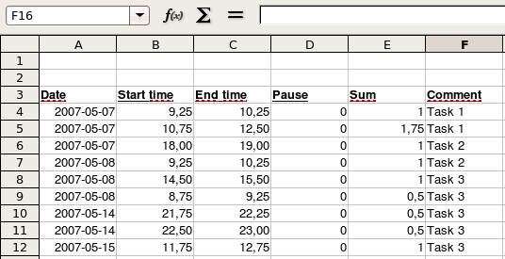
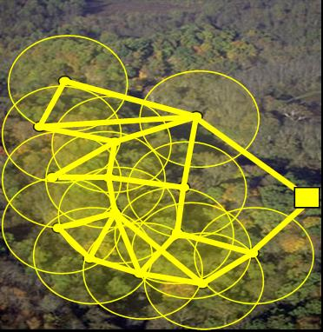
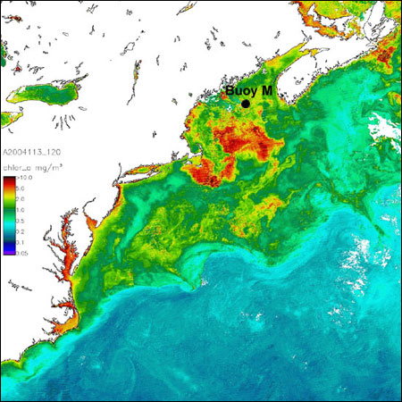
Data Found in DataONE
Biological
e.g., Gene, Organism, Population, Species, Community, Biome, Ecosystem
Environmental
e.g., Atmospheric, Chemical, Ecological, Hydrological, Oceanographic, Physical
Social
e.g., Land use, human population
Economic
e.g., trade, ecosystem services, resource extraction
Notes:
Life has many different layers of organization – from the molecules that are the basis of our DNA, to the cells of our body, to the individuals that form populations and then a species. A group of species within a region form communities, and communities form biomes.
Demonstrative slide, not illustrative.
Placement of these concepts is general and still under development. Slide more to show basic scale and complexities, than interdependence.
Natural and human factors can affect all levels. For instance, pollution affects the physical well-being of organisms, thus affecting a population. Certain species might be affected by pollution more than others, changing the composition of communities, and eventually ecosystems. The answers to potential research questions can differ depending on the layer.

Slide 4
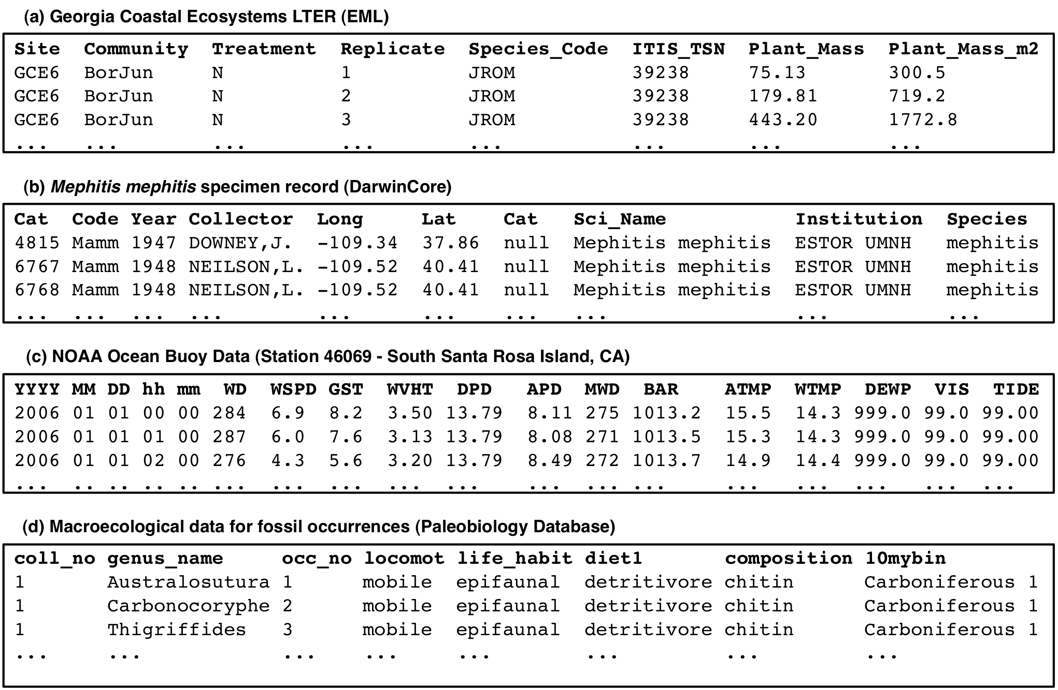
Data heterogeneity
Space
Time
Taxa
Notes:
What are the tendencies for the development of informatics tools to support biodiversity conservation?
How these tools may be used to support policy/ decision makers for implementing public policies on biodiversity conservation and management?

Slide 5

Semantics Research efforts
Data Integration and Semantics WG
Jeff Horsburgh
Deborah McGuinness
Luis Bermudez
Damian Gessler
Carl Lagoze
Hilmar Lapp
Natasha Noy
Line Pouchard
Carlos Rueda
Mark Schildhauer
Paulo Pinheiro da Silva
Patrice Seyed
SONet & SemTools
Mark Schildhauer
Matt Jones
Ben Adams
Shawn Bowers
Stacy Hespanha
Chris Jones
Ben Leinfelder
Deborah McGuinness
Margaret O’Brien

Slide 6
Approaches to Discovery and Integration
Traditional Term Matching
Formal Semantics
Statistical Topic Models
DataONE’s approach: Hybrid combination
Notes:
, chemical, organismal, geospatial

Slide 7
Traditional Term Matching
Poor Precision
Poor Recall
Literal text matches miss
hypernyms and hyponyms
term matching (TF-IDF)
ranked list of metadata records matching query
query
Can be weighted based upon how often a term appears in a specific document compared to how often it appears in an entire corpus (TF-IDF: Term frequency-inverse document frequency)

Slide 8
Adding Formal Ontologies
Improved Precision
Improved Recall
Query expansion based on formally-defined relationships between concepts
formal ontologies/
controlled vocabularies
term matching
(TF-IDF)
ranked list of metadata records matching query
query
High-level and domain-specific ontologies specify formal and explicit representation of relationships between concepts (e.g., parent-child-sibling relationships; synonyms, partonyms, hypernyms)

Slide 9
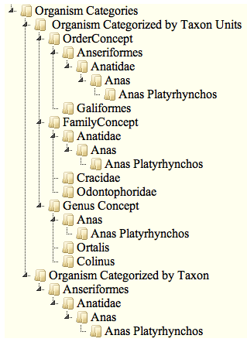
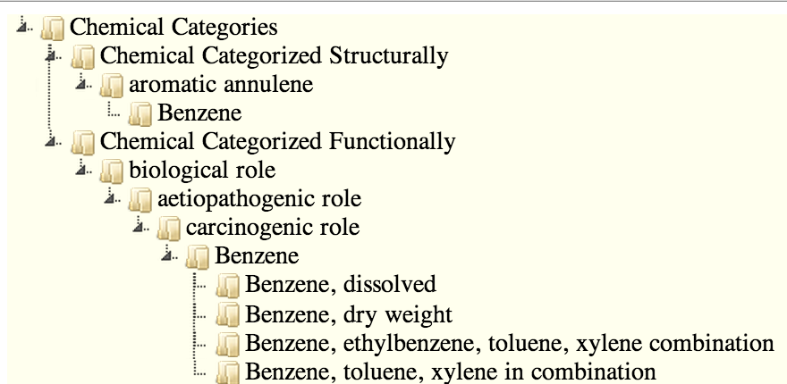
Develop Formal Vocabularies/Ontologies
Meta-Modeling of Species Taxonomies (Right)
Modeling Chemical on Structure, Role,
and Contexts (Below)
Enable paths to data given interest of the user
Notes:
(Right) This is the expert view of bird organism classification (right) with a scientific name hierarchy.
If one was reviewing a layperson view, common names would be used instead where available.
This structure enables “drill down” and search starting at different taxon unit levels (Order, Family, Genus, etc.) or taxon levels implicit in the hierarchy (bottom node in the tree “Organism Categorized by Taxon).
(Below) we model chemicals based on structure, role, and context.
We can use both sets structures to facilitate search of datasets based on inclusion of these terms/notions in the metadata.

Slide 10
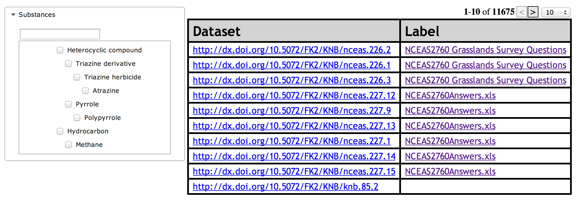
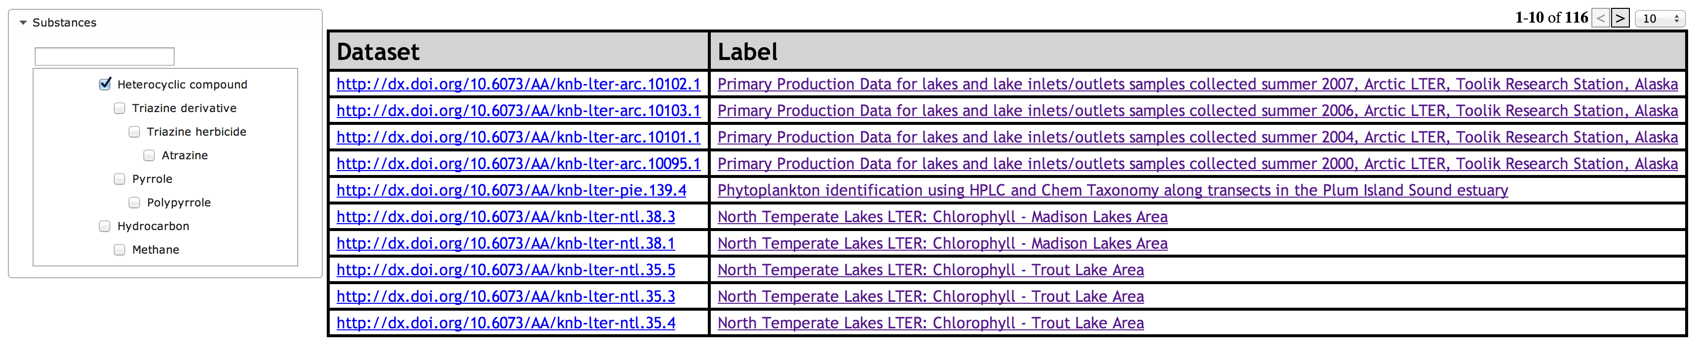
Hierarchical Faceted Search
11,675 results
116 results
Notes:
Using these hierarchies to support dataset level search over the same datasets and all dataone “cataloged” datasets.
A Search on data including the notion “Heterocyclic compound” (based on selection shown), which provide search results including categories “Triazine derivation” (Role) and Atrazine (among substances that play that role).

Slide 11
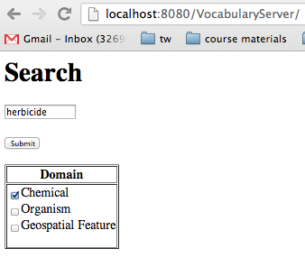
Query Expansion
Search for ‘herbicide’
“Upward” expansion: ‘Agrochemical biocide, Biocide, Chemical’
“Downward” expansion: ‘Triazine herbicide’, ‘Atrazine’
Match Original Term and Expansions against metadata
Notes:
This slide represents the same sort of search as the previous except that instead of having an index structured by generalization links the query is expanded to more specific categories “on the fly”.
This simply demonstrates that we can use community based ontologies/vocabularies the links and ontologies our group provides as a foundation for multiple types of search interfaces.

Slide 12
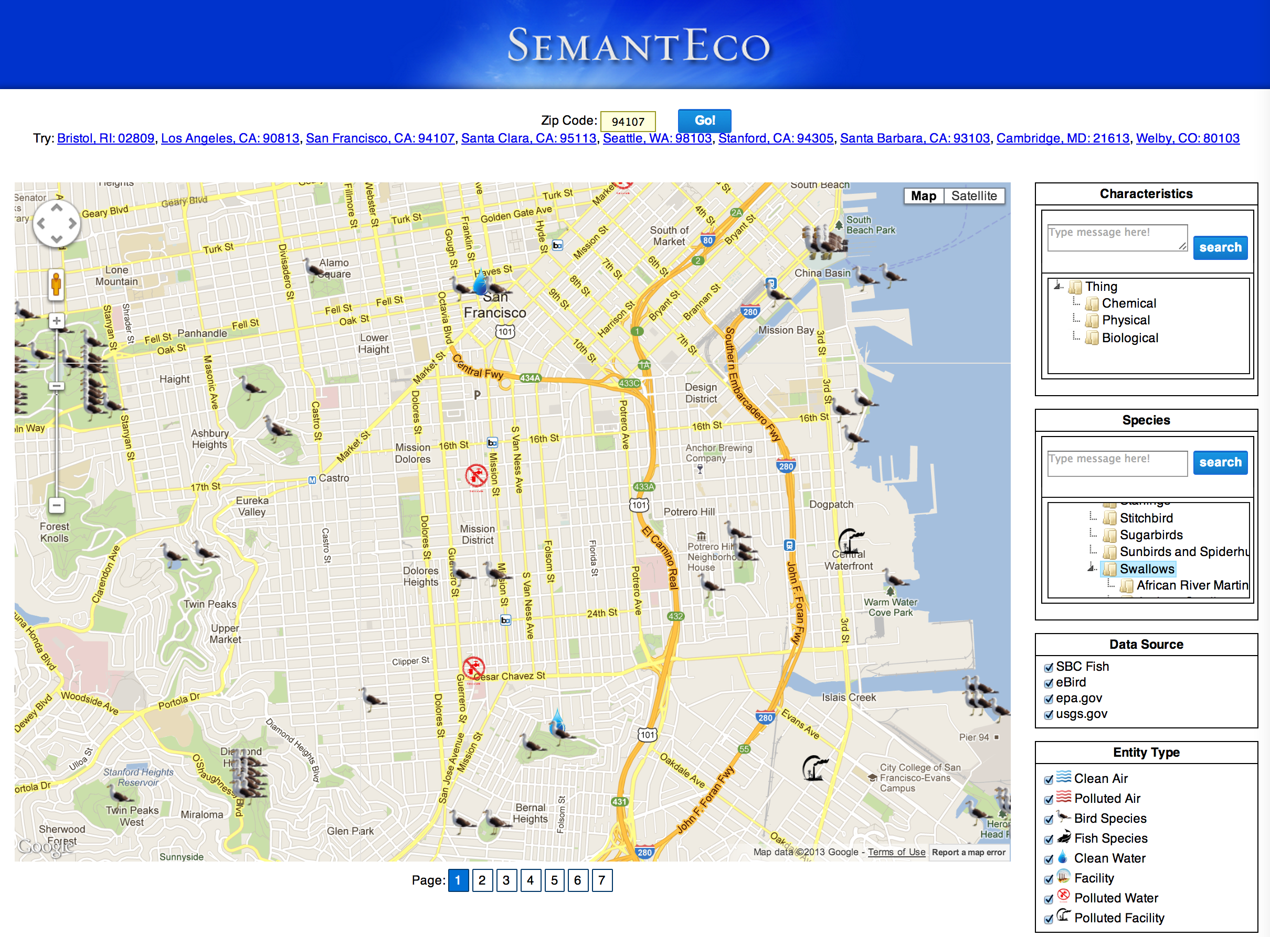
Figure: SemantEco Hierarchical Faceted Search
Notes:
SemantEco is a framework for integrating data that leverages semantic technologies, community based ontologies, and software engineering best practices (modular design).
Pipeline for processing data:
We convert data into RDF using automated tools along with the vocabulary we provided
We reason about polluted sites and polluting facilities using a Description Logic Reasoner
Which all enables the user interface for searching for water data and occurences of pollution and related health effects
We visualize the data and provide numerous interactive interfaces that support drill down and provenance exposure

Slide 13
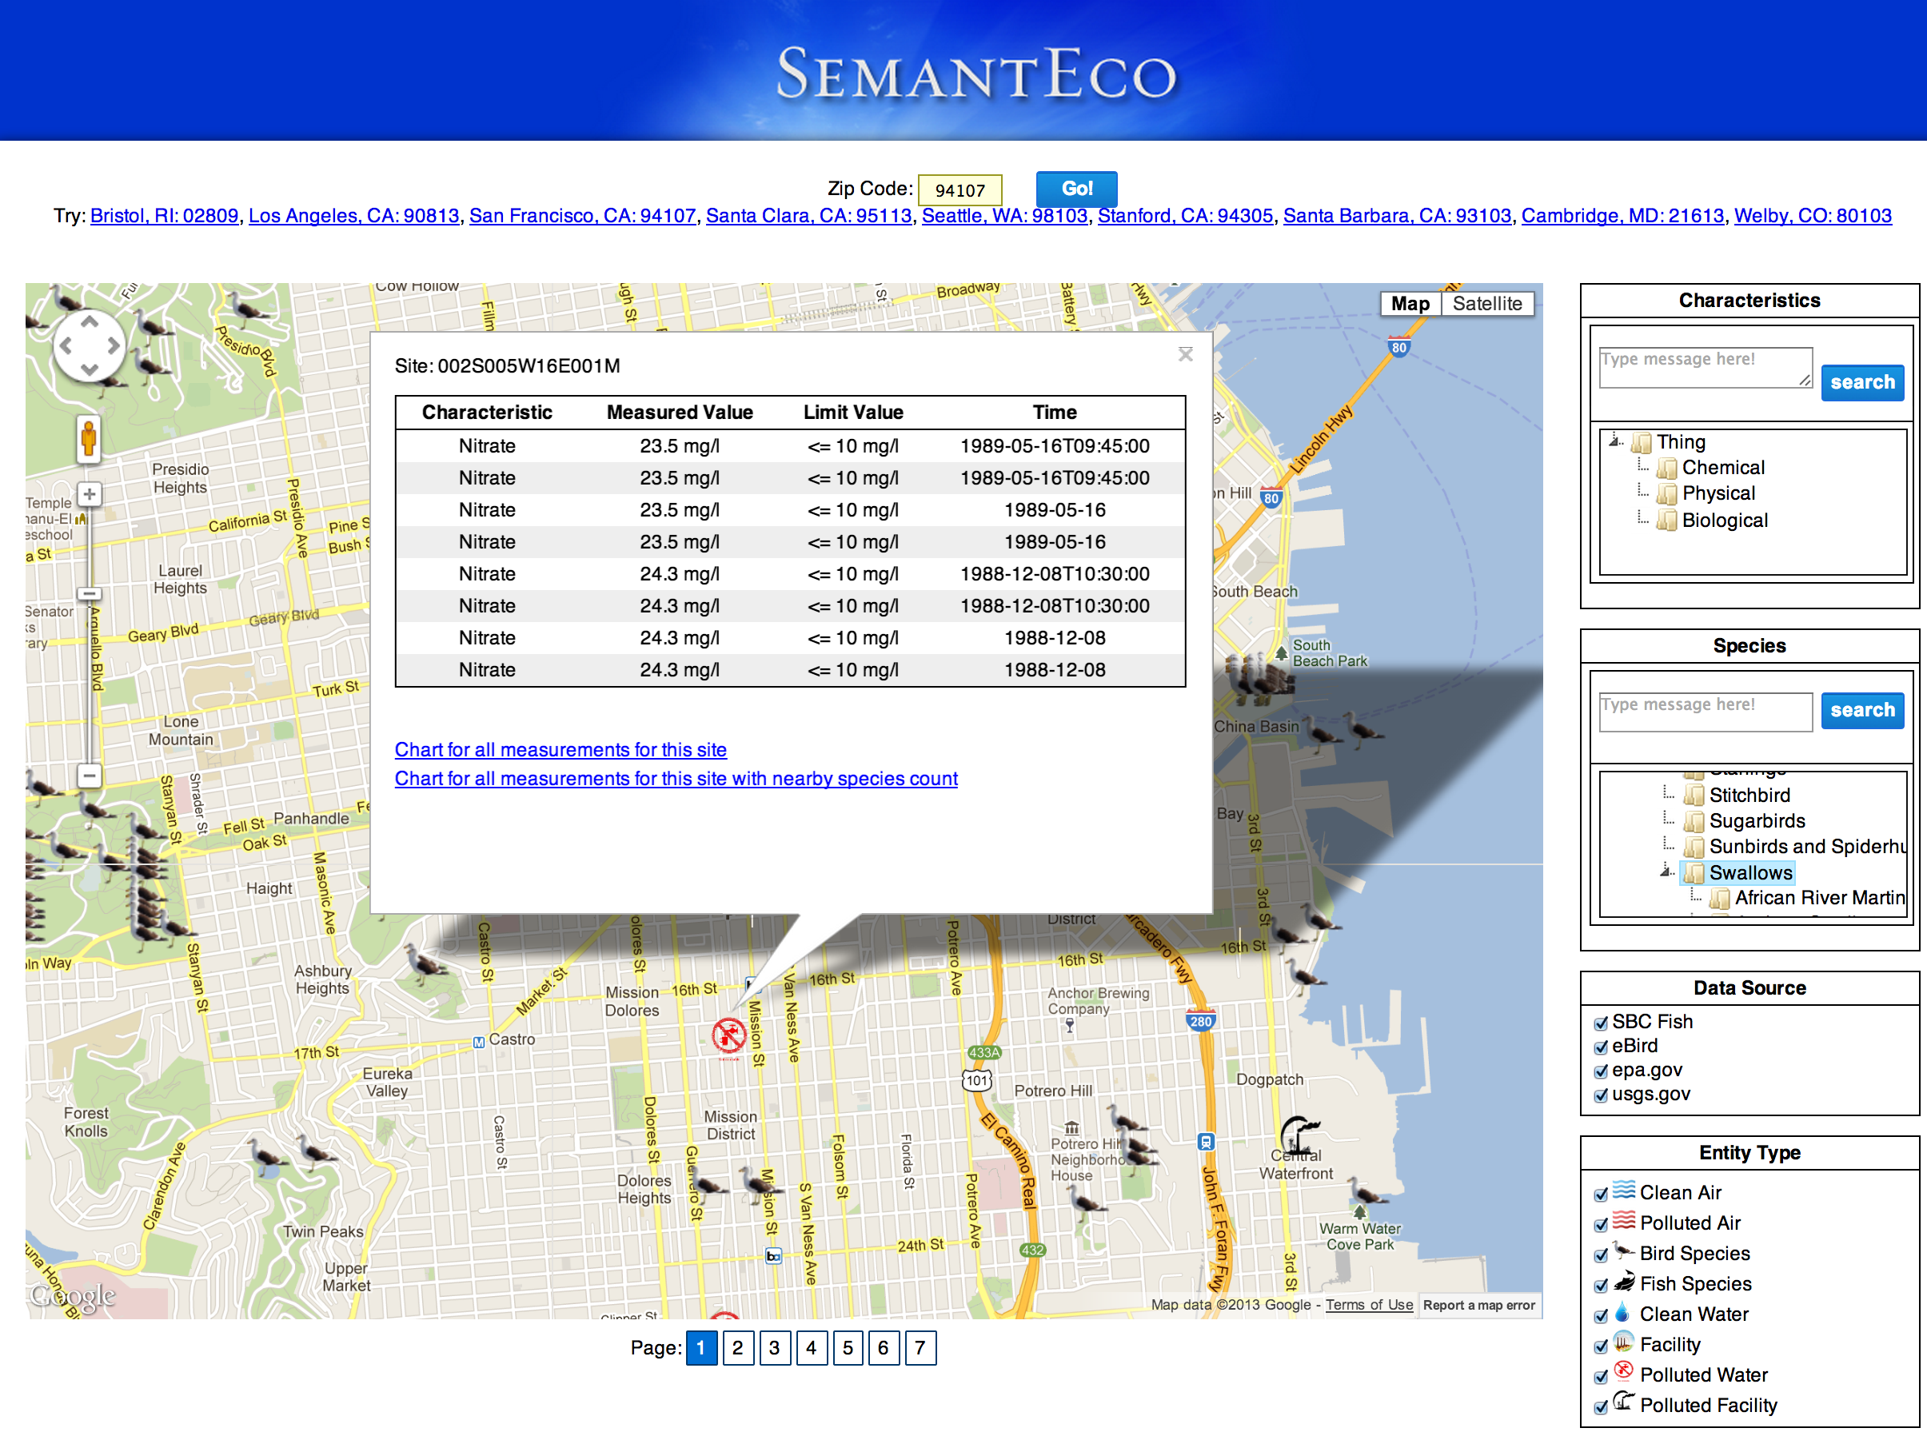
4
4
Map view of analyzed results
Explanation of pollution
Plotting specific measurement data alone or alongside species count data
Filtering by facet to select type of data
2
2
3
3
1
1
Notes:
Enable/Empower citizens & scientists to explore pollution sites, facilities, regulations, and health impacts along with provenance.
Demonstrates semantic monitoring possibilities.
Map presentation of analysis
Explanations and Provenance available
Map view of analyzed results
Explanation of pollution
Plotting specific measurement data alone or alongside species count data
Filtering by facet to select type of data

Slide 14
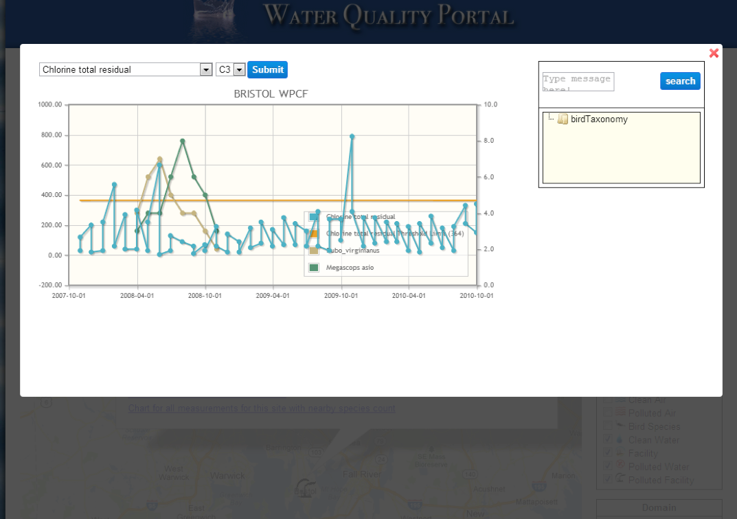
Notes:
SemantEco: Plotting Water Data with Bird Count Data

Slide 15
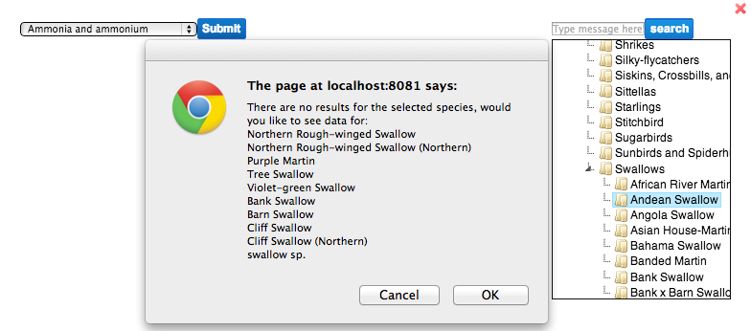
SemantEco: Sibling Suggestor
The current bird population data is sparse, thus some common birds, including swallows, may have no data loaded. The interface suggests similar birds for which data exists.
Notes:
This one was informed by the eBird.

Slide 16
Challenge: Linking data to ontology
SteelheadPopulationSample
uses-standard
Number
OBOE Salmon
Ontology
is-a
has-characteristic
Count
AliveWildSmoltSteelheadPopulationSample
1
has-precision
of-entity
of-entity
OBOE Semantic
Annotation
Observation
Observation
has-measurement
of-characteristic
has-measurement
Measurement
of-characteristic
Measurement
<attribute id=”att.4”>
<attributeName>
live_stlhd_smolt
</attributeName>
</attribute>
<attribute id=”att.5”>
<attributeName>
live_count
</attributeName>
</attribute>
Structural
Metadata
date | live_stlhd_smolt | dead_stlhd_smolt
2/15/09 | 27 | 2
2/16/09 | 34 | 0
date | species | live_count | dead_count
2/15/09 | STHD | 45 | 0
2/16/09 | COHO | 23 | 1
Data
Notes:
The OBOE semantic annotations are the glue that link data to the ontology concepts. Note that the right annotation uses a conditional mapping based on the subset of species (STHD)

Slide 17
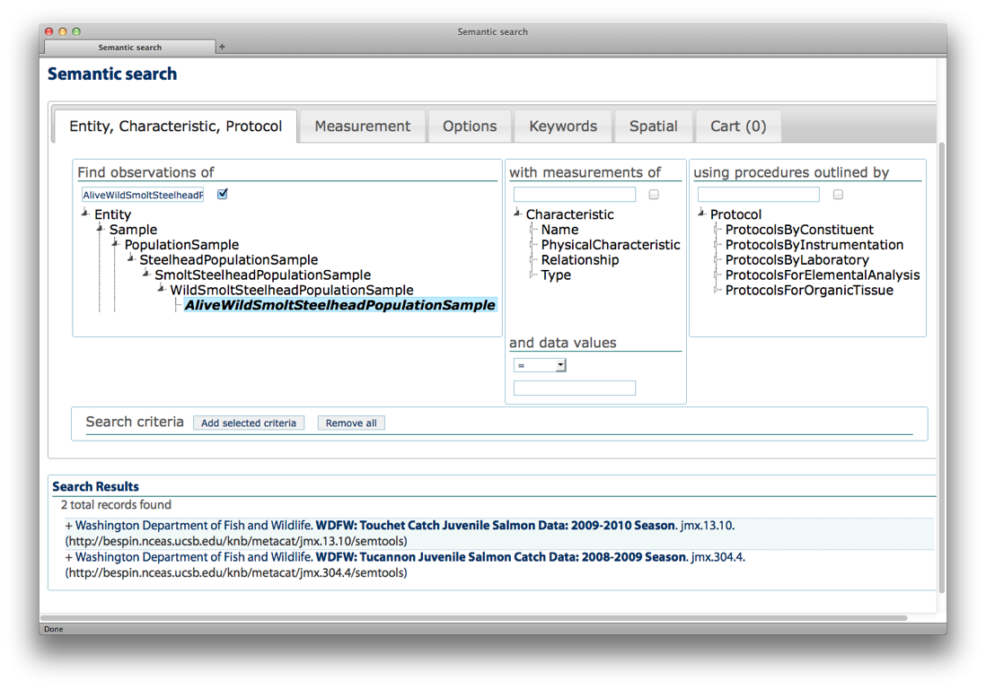
Search Example: “steelhead”
Notes:
Query Expansion: if you search for

Slide 18
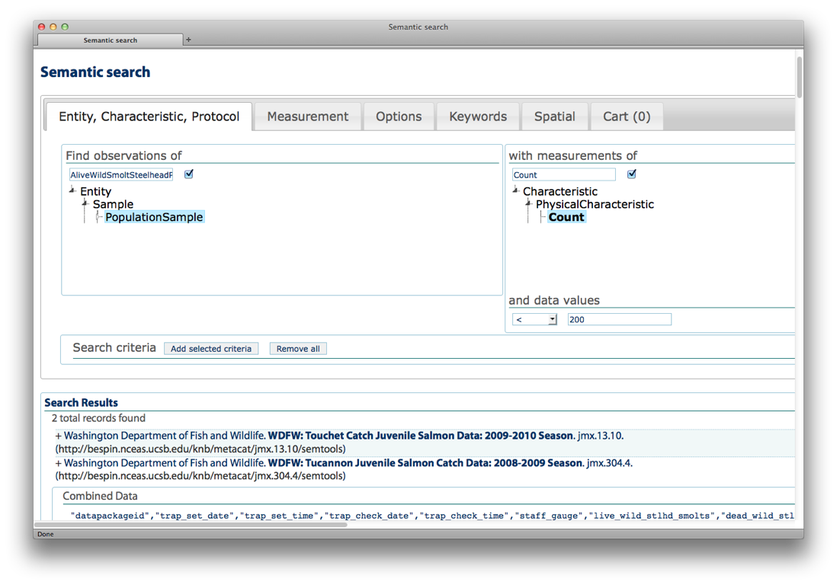
Towards Data Integration

Slide 19
Adding Topic Models
Query expansion based on statistically-defined relationships between concepts
formal ontologies/
controlled vocabularies
term matching
(TF-IDF)
ranked list of metadata records matching query
query
topic model
Topic model identifies latent ‘topics’ based on term co-occurrence in natural language metadata such as title, abstract, keywords and represents metadata records as mixtures of probable topics

Slide 20
Adding Topic Models
Improved Recall
Automated
expand query to include ‘braconidae’, ‘ichneumonidae’
formal ontologies/
controlled vocabularies
term matching
(TF-IDF)
ranked list of metadata records matching query
query
“parasitic wasp”
topic model
expanding query based on relevant ‘topic’ returns records that contain ‘host’, ‘parasitism’, ‘biological control’, ‘caterpillar’, ‘host specificity’

Slide 21
Refinement of Formal Semantic and Topic Models
known relationships between terms can be used to constrain topic model
formal ontologies/
controlled vocabularies
topic model reflects how researchers actually describe their data; experts in semantic representation can use this information to develop better ontologies for earth and environmental sciences
topic model

Slide 22
Powerful Data Discovery via Semantics
Improved Precision
Improved Recall
Automated annotation
outcomes
Enhanced models for knowledge representation in earth and environmental sciences
formal ontologies/
controlled vocabularies
term matching
(TF-IDF)
query
Powerful model-driven search interface for data discovery
topic model

Slide 23
Future Work
Incorporate advances into DataONE Discovery
Push the Envelope on the Hybrid Approach
Refine Vocabulary Services
Work on ad-hoc data integration

Slide 24
Summary
We provided a vision of semantically enabling ecological and environmental data
Enhanced search capabilities are being developed leveraging
Best practices community-developed vocabularies
Semantic tools for identifying related, consistent, or inconsistent terms
Natural language processing tools and techniques
Provenance and annotation tools and techniques

Slide 25
Adding Formal Ontologies
expand query to include ‘braconidae’, ‘ichneumonidae’, ‘hymenoptera’
formal ontologies/
controlled vocabularies
term matching
(TF-IDF)
ranked list of metadata records matching query
query
“parasitic wasp”

Slide 26
Topic Model Representation of Semantic Content
probability that this record contains this topic
one row per metadata record
characteristic terms for topic 5

Slide 27
Hybrid Statistical-Formal Semantic Approach to Supporting Data Discovery
formal ontologies/
controlled vocabularies
model tuning based upon formal evaluation of precision and recall
term matching
(TF-IDF)
ranked list of metadata records matching query
query
topic model

Slide 28
Introduction
SemantEco
Goal to provide a framework that, for purposes of integrating, accessing, and visualizing any type of environment-relevant data, enables anyone to assume the roles of data producer and data user.
Vocabulary Services for Annotation and Search
Developing suite of vocabulary Services hinging on community-driven ontologies from multiple domains, drawing on expertise of WG for Quality Assurance and Alignment
Services as a “backbone” of knowledge for SemantEco as well as Hierarchical and Free-text Search
Hybrid Annotation and Search Capabilities
Developing techniques of combining vocabulary services with NLP methods (including Topic Modeling) for enhancing query expansion, search result ranking, identifying ontology gaps
Evaluation of Search based on ontology-driven, topic model-driven, and hybrid approaches
Notes:
, chemical, organismal, geospatial

Slide 29





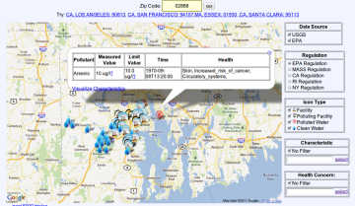

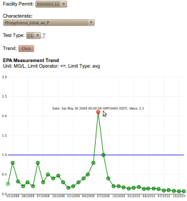

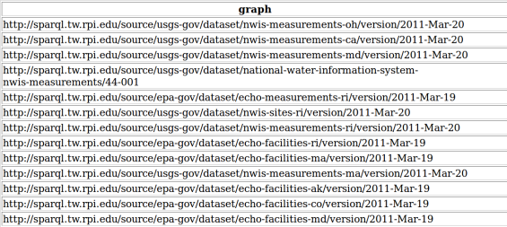

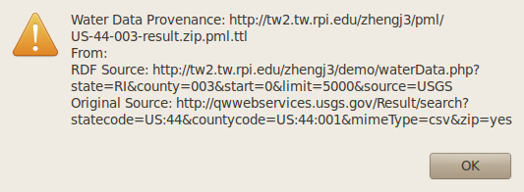
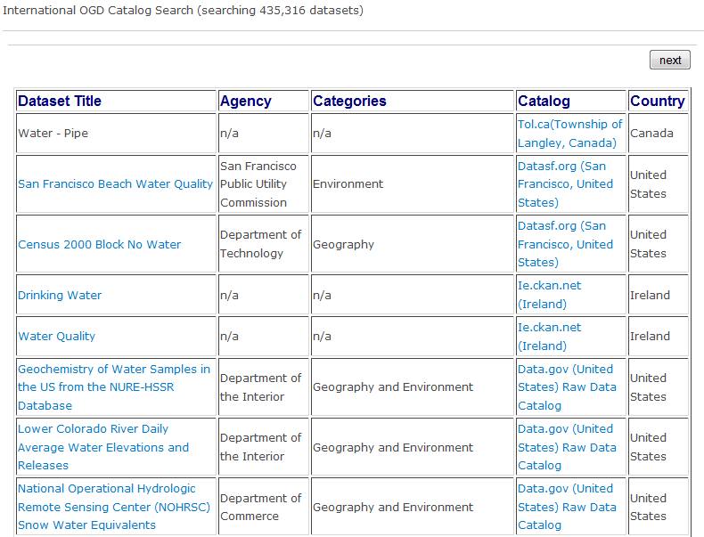
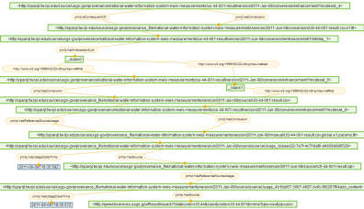


SemantEco Workflow
Publish
CSV2RDF4LOD
Direct
Reason
Visualize
derive
derive
integrate
archive
Archive
CSV2RDF4LOD
Enhance
Notes:
We convert data into RDF using automated tools along with the vocabulary we provided
We reason about polluted sites and polluting facilities using a Description Logic Reasoner
Which all enables the user interface for searching for water data and occurences of pollution and related health effects
We visualize the data and provide numerous interactive interfaces that support drill down and provenance exposure

Slide 30
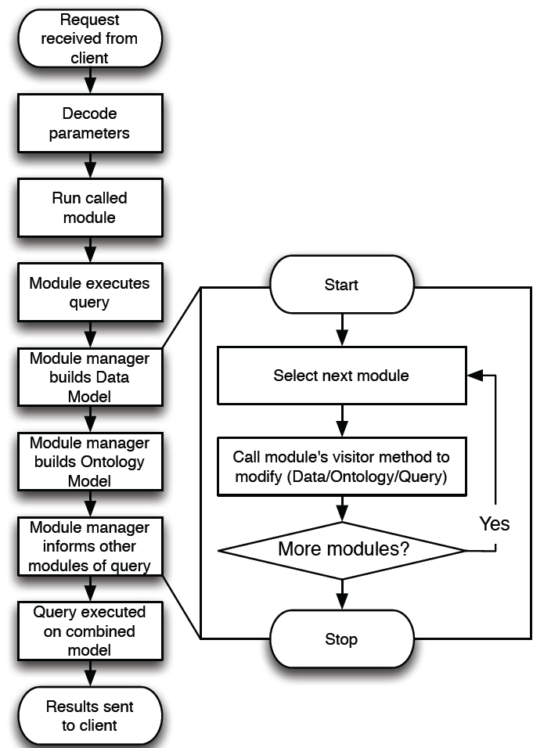
SemantEco Modular Framework
Modularization at the domain level filters down to all aspects of the framework, including the codebase, the ontologies, and query execution that respond to interface selection.
Advances current Semantic Web/AI practices due to its modular architecture, allowing users to customize behavior via modules or include data based on domain (water, air, organism data).
Notes:
Ingests semantically-enabled (i.e. RDF-encoded) data and OWL ontologies to provide search features, data interpretation, and visualization tools to end users.

Slide 31
Notes:
SemantEco: Plotting Water Data with Bird Count Data

Slide 32
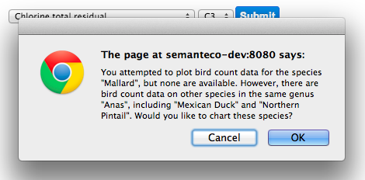
SemantEco: Sibling Suggestor
The current bird population data is sparse, thus some common birds, including mallard, may have no data loaded. The interface suggests similar birds for which data exists
Notes:
This one was informed by the eBird.

